Slide 1
Identifying Important Risk Factors for Future Mania in Individuals with Major Depressive Disorder Using Weighted Random Forest Models and the NESARC Dataset
Jialiang Hua
Supervisor: Melanie M. Wall

Slide 2
Background/Introduction
Most individuals with bipolar disorder undergo one or more major depressive episodes prior to their first manic episode.
Identifying individuals with unipolar depression who are at high risk for a manic episode, and potential progression to bipolar disorder, allows for targeted interventions, symptom surveillance, and possible preventative research.
My project aimed to identify important risk factors for future mania in individuals with major depressive disorder using the National Epidemiologic Survey on Alcohol and Related Conditions (NESARC) dataset and the Weighted Random Forest algorithm.

Slide 3
Data
The National Epidemiologic Survey on Alcohol and Related Conditions (NESARC) is a nationally representative household survey of 43,093 participants that covered alcohol, drug and psychiatric disorders, risk factors, and consequences.
Wave 1 of the NESARC was conducted in 2001-2002. Three years later, Wave 2 follow-up re-interviews were conducted with 34,653 of the original participants.
We investigated the clinical and social determinants of the transition from Major Depressive Disorder (MDD) to bipolar disorder based on the NESARC dataset.
Our analytic sample included all Wave 1 participants with MDD diagnosis, as defined in NESARC by lifetime MDD history without lifetime manic or hypomanic episode. Weighted Random Forest was employed to identify risk factors for a manic episode occurring during the study's three-year follow-up period.

Slide 4
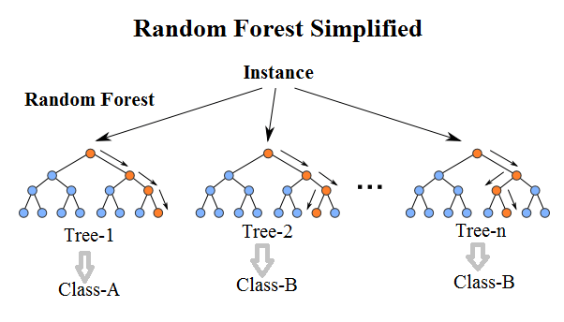
Methods
Due to class imbalance (mania : not developing mania = 341 : 4878), we chose the weighted random forest algorithm for its effectiveness in handling imbalanced data.
Mania samples have little influence during the progress of classification using common random forest algorithm.
By assigning higher penalties to misclassified instances from the minority class, Weighted Random Forest enhances the model's ability to accurately predict outcomes for underrepresented groups.

Slide 5
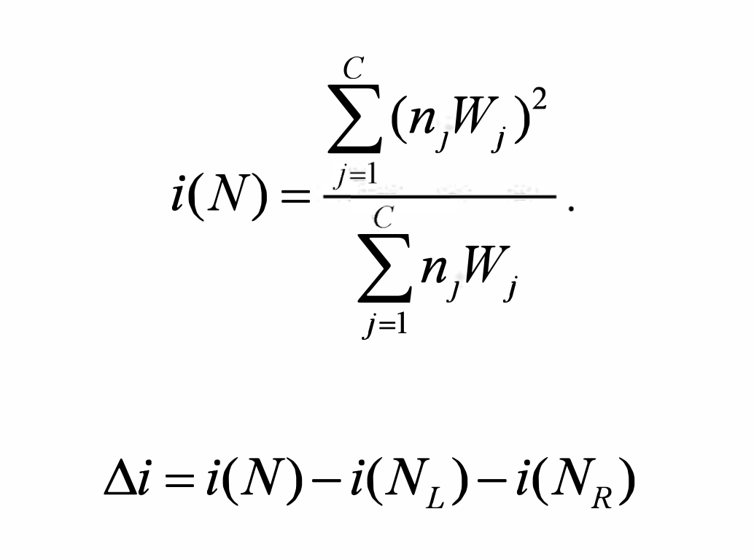
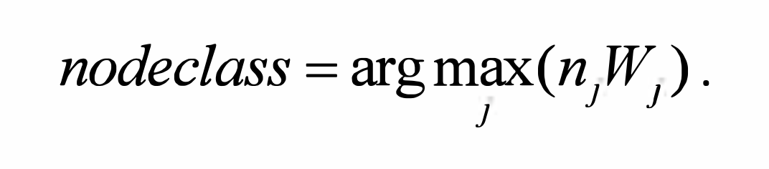
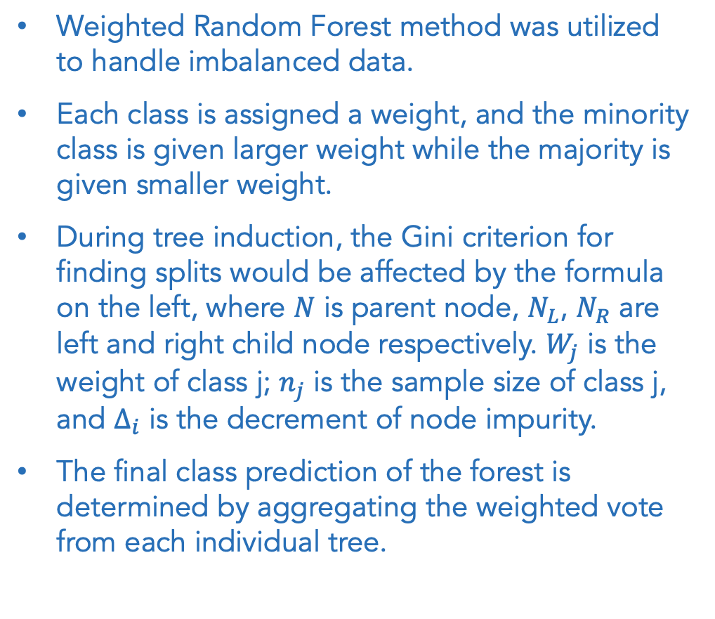
Methods
Weighted Random Forest method was utilized to handle imbalanced data.
Each class is assigned a weight, and the minority class is given larger weight while the majority is given smaller weight.
During tree induction, the Gini criterion for finding splits would be affected by the formula on the left, where $N$ is parent node, $N_{L}$, $N_{R}$ are left and right child node respectively. $W_{j}$ is the weight of class j; $n_{j}$ is the sample size of class j, and $∆_{i}$ is the decrement of node impurity.
The final class prediction of the forest is determined by aggregating the weighted vote from each individual tree.
Notes:
The minority class should be placed a heavier penalty on misclassifying. The class weight would affect random forest algorithm in the following two places.
In tree induction procedure, class weights are used to weight Gini criterion for finding splits. In the terminal nodes of each tree, class weights were again considered. The class prediction of each terminal node was determined by a "weighted majority vote" (i.e., the weighted vote of a class is the weight for that class times the number of cases for that class at the terminal node). The final class prediction for the random forest was determined by aggregating the weighted vote from each individual tree, where the weights are average weights in the terminal nodes.^{[13]}

Slide 6
Methods
We selected the variables based on previous literature.
We included in our model participant demographic characteristics, clinical characteristics of depression, lifetime psychiatric disorders, and past-year stressors.
Category | Variables
Demographic factors | age, sex, race, educational attainment
Clinical characteristics of depression | age at onset, first depression onset in the past year, presence of atypical features (3 variables), number of lifetime depressive episodes, high family history loading of depression (14 variables)
Lifetime psychiatric disorders | panic disorder, social phobia, generalized anxiety disorder, alcohol dependence (2 variables), nicotine dependence, cannabis abuse or dependence (2 variables), other substance dependence (17 variables)
Past-year stressors | social support group problems (3 variables), social environmental problems (2 variables), occupational problems (4 variables), economic problems
Notes:
We used a hypothesis-driven approach.

Slide 7
Methods
We built three weighted random forest models as follows:
Model 1 (Categorical variable model) used only categorical variables, with all continuous variables transformed into categorical ones (tertiles).
Model 2 (Continuous variable model) incorporated both categorical and continuous variables when applicable.
Model 3 (Pre-processed variable model) utilized processed variables based on our knowledge.

Slide 8
Results
Model | Categorical variable model | Continuous variable model | Pre-processed variable model
AUC | 0.689 | 0.701 | 0.688
Mtry | 3 | 4 | 1
Minimum node size | 6 | 12 | 10

Slide 9
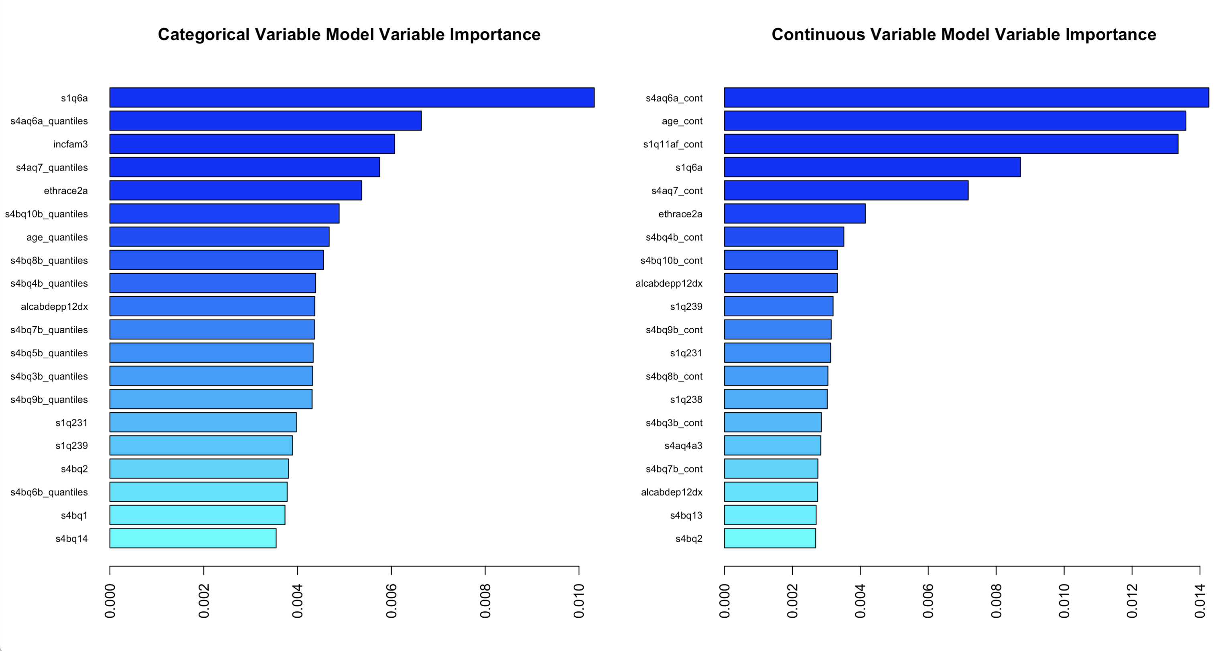
Results
Fig 1 Variable Importance of two models
The top important variables include age at onset of first episode, age, annual family income, education level and number of lifetime depressive episodes.

Slide 10
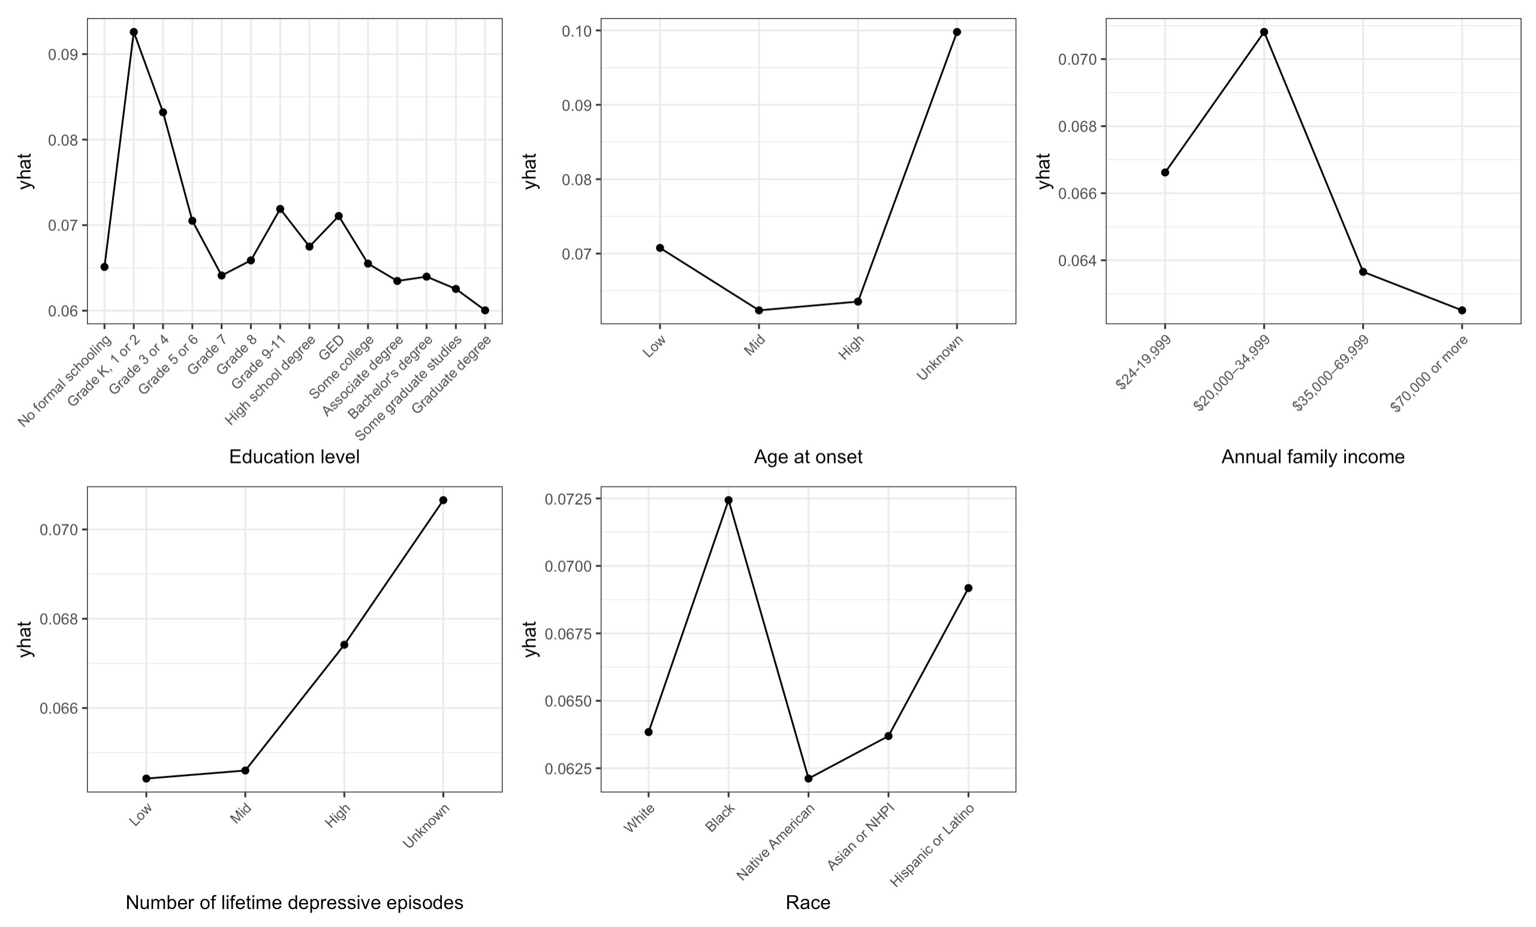
Results
Fig 2 Partial dependence plot of categorical variable model

Slide 11
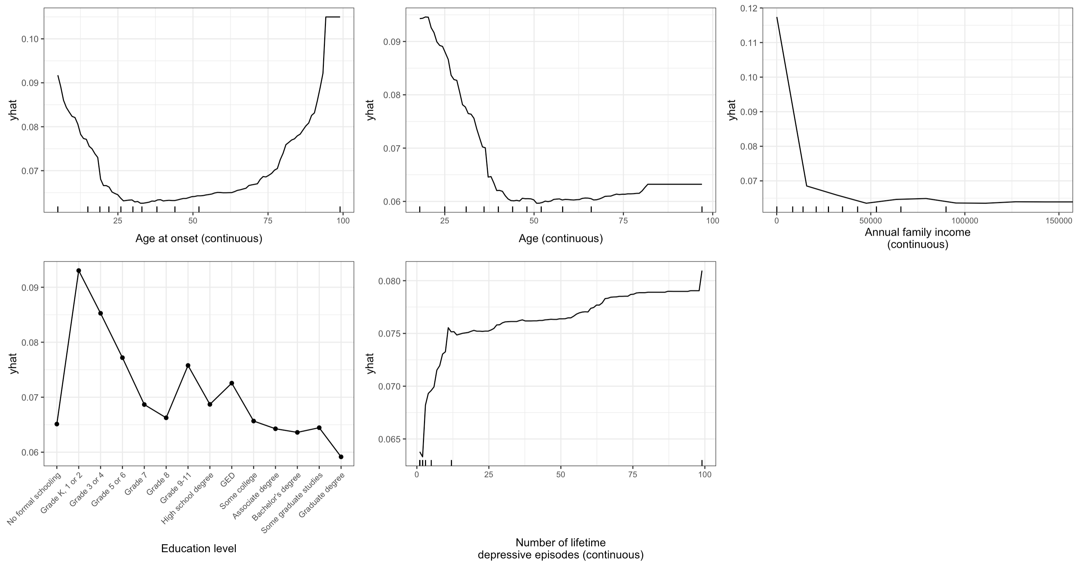
Results
Fig 3 Partial dependence plot of continuous variable model

Slide 12
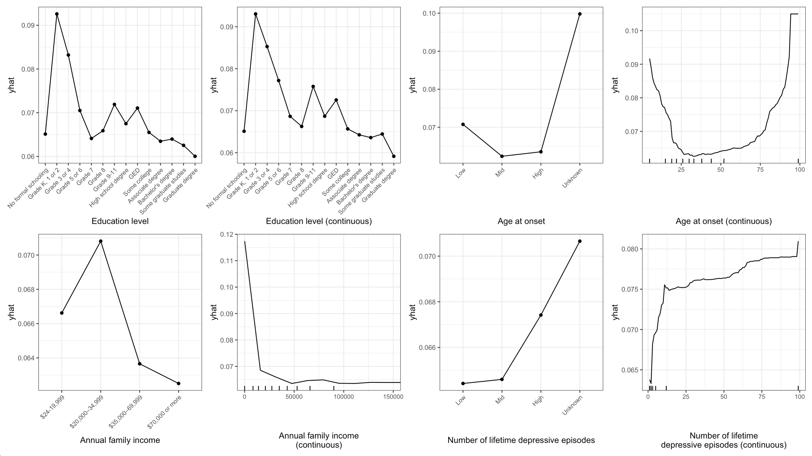
Results
Fig 4 Partial dependence plot of categorical variable model versus continuous variable model

Slide 13
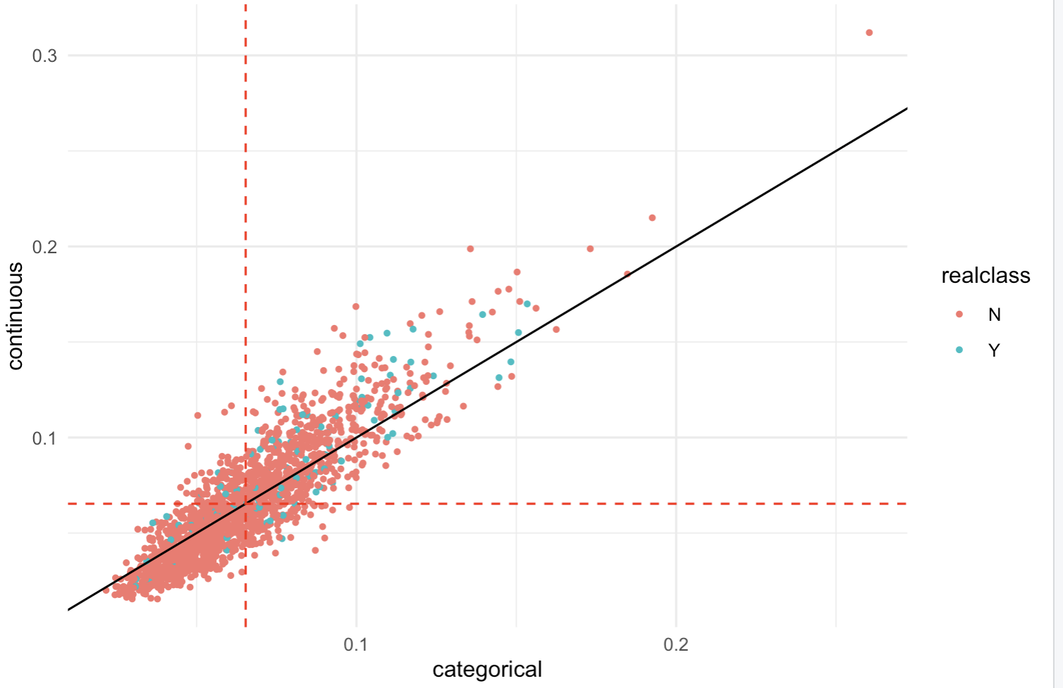
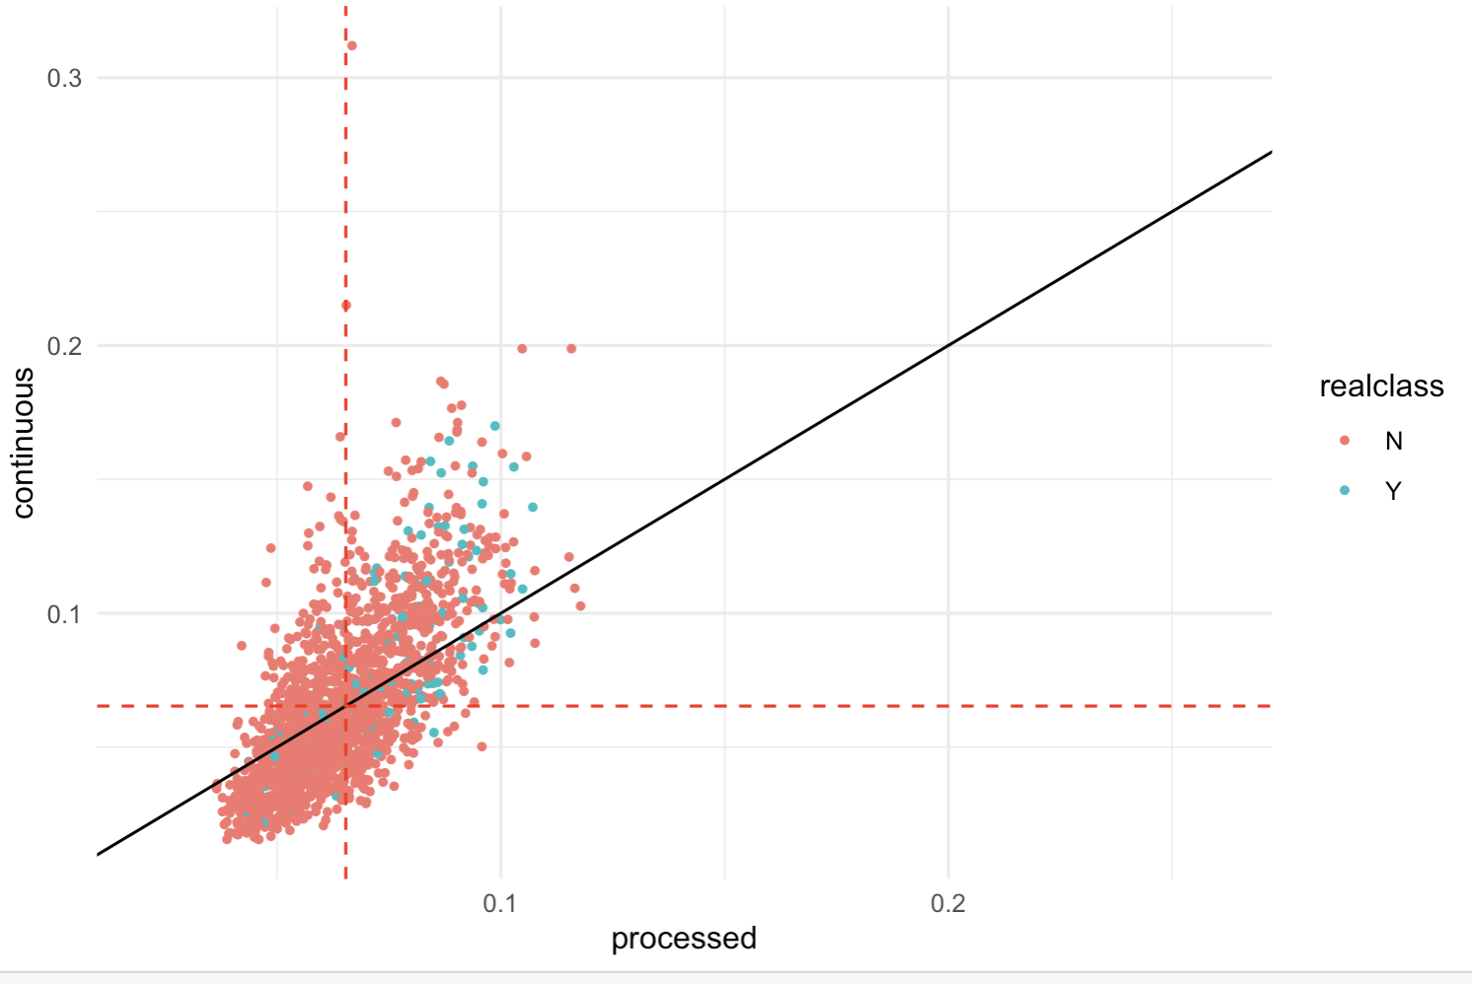
Results
Fig 5 Scatter plot of the predicted probabilities

Slide 14
Conclusions
The most important risk factors include age at onset of first episode, current age, annual family income, education level and number of lifetime depressive episodes.
Our results are highly consistent with previous studies. Younger age, earlier onset, lower family income, Black race/ethnicity, lower education level and increased lifetime depressive episodes are associated with a higher risk of transition from MDD to bipolar disorder.
Continuous variable model displays higher importance scores for continuous variables compared to their categorical counterparts in the categorical variable model.
The AUC of the pre-processed variable model remains stable even after collapsing the variables and reducing the number of variables from 59 to 21.
For true mania cases, the continuous variable model produces higher prediction probabilities than both the categorical and pre-processed variable models.

Slide 15
Discussion
Our findings closely align with a prior study utilizing the same NESARC dataset and objective; however, the previous study employed a logistic regression model instead.
Insufficient domain knowledge during the pre-processed variable model development may have limited optimization. Collaborating with domain experts to collapse variables could potentially enhance the model's AUC further.
The rise in variable importance for continuous variables may be attributed to the random forest algorithm's inherent feature selection for continuous variables.
In this study, we used the class weights derived by prevalence, which might not be optimal. Tuning this parameter could potentially lead to enhanced performance.

Slide 16
Reference
[1] Anderson, I. M., Haddad, P. M., & Scott, J. (2012). Bipolar disorder. BMJ (Clinical research ed.), 345, e8508. https://doi.org/10.1136/bmj.e8508
[2] Perlis, R. H., Delbello, M. P., Miyahara, S., Wisniewski, S. R., Sachs, G. S., Nierenberg, A. A., & STEP-BD investigators (2005). Revisiting depressive-prone bipolar disorder: polarity of initial mood episode and disease course among bipolar I systematic treatment enhancement program for bipolar disorder participants. Biological psychiatry, 58(7), 549–553. https://doi.org/10.1016/j.biopsych.2005.07.029
[3] Mitchell, P. B., Goodwin, G. M., Johnson, G. F., & Hirschfeld, R. M. (2008). Diagnostic guidelines for bipolar depression: a probabilistic approach. Bipolar disorders, 10(1 Pt 2), 144–152. https://doi.org/10.1111/j.1399-5618.2007.00559.x
[4] Schaffer, A., Cairney, J., Veldhuizen, S., Kurdyak, P., Cheung, A., & Levitt, A. (2010). A population-based analysis of distinguishers of bipolar disorder from major depressive disorder. Journal of Affective Disorders, Mar 9.
[5] Perlis, R. H., Brown, E., Baker, R. W., & Nierenberg, A. A. (2006). Clinical features of bipolar depression versus major depressive disorder in large multicenter trials. The American journal of psychiatry, 163(2), 225–231. https://doi.org/10.1176/appi.ajp.163.2.225
[6] Andreasen, N. C., Grove, W. M., Coryell, W. H., Endicott, J., & Clayton, P. J. (1988). Bipolar versus unipolar and primary versus secondary affective disorder: which diagnosis takes precedence?. Journal of affective disorders, 15(1), 69–80. https://doi.org/10.1016/0165-0327(88)90011-0

Slide 17
Reference
[7] Solomon, D. A., Leon, A. C., Maser, J. D., Truman, C. J., Coryell, W., Endicott, J., Teres, J. J., & Keller, M. B. (2006). Distinguishing bipolar major depression from unipolar major depression with the screening assessment of depression-polarity (SAD-P). The Journal of clinical psychiatry, 67(3), 434–442. https://doi.org/10.4088/jcp.v67n0315
[8] Serretti, A., Mandelli, L., Lattuada, E., Cusin, C., & Smeraldi, E. (2002). Clinical and demographic features of mood disorder subtypes. Psychiatry research, 112(3), 195–210. https://doi.org/10.1016/s0165-1781(02)00227-5
[9] Benazzi F. (2003). Clinical differences between bipolar II depression and unipolar major depressive disorder: lack of an effect of age. Journal of affective disorders, 75(2), 191–195. https://doi.org/10.1016/s0165-0327(02)00047-2
[10] Guze, S. B., Woodruff, R. A., Jr, & Clayton, P. J. (1975). The significance of psychotic affective disorders. Archives of general psychiatry, 32(9), 1147–1150. https://doi.org/10.1001/archpsyc.1975.01760270079009
[11] Perlis, R. H., Ostacher, M. J., Uher, R., Nierenberg, A. A., Casamassima, F., Kansky, C., Calabrese, J. R., Thase, M., & Sachs, G. S. (2009). Stability of symptoms across major depressive episodes in bipolar disorder. Bipolar disorders, 11(8), 867–875. https://doi.org/10.1111/j.1399-5618.2009.00764.x
[12] Gilman, S. E., Dupuy, J. M., & Perlis, R. H. (2012). Risks for the transition from major depressive disorder to bipolar disorder in the National Epidemiologic Survey on Alcohol and Related Conditions. The Journal of clinical psychiatry, 73(6), 829–836. https://doi.org/10.4088/JCP.11m06912

Slide 18
Reference
[13] Chen, C. (2004). Using random forest to learn imbalanced data (Doctoral dissertation). Department of Statistics, University of California, Berkeley.
[14] Strobl, C., Boulesteix, A. L., Zeileis, A., & Hothorn, T. (2007). Bias in random forest variable importance measures: illustrations, sources and a solution. BMC bioinformatics, 8, 25. https://doi.org/10.1186/1471-2105-8-25

